Slide 1



Intro to KPIs:
Industry-Specific Metrics Critical to Profitability
Presented by:
Jessica Boulerice of The LMC Group and
Sami Elotmani of Destination MCO

Slide 2


Intro to KPIs:
Industry-Specific Metrics Critical to Profitability
sami elotmani & Jessica Boulerice

Slide 3

Goals for the Session
Top 10 industry- specific KPIs
  Why are they important?
  How do you calculate them?
  How can you improve them?
Q&A after each KPI

Slide 4
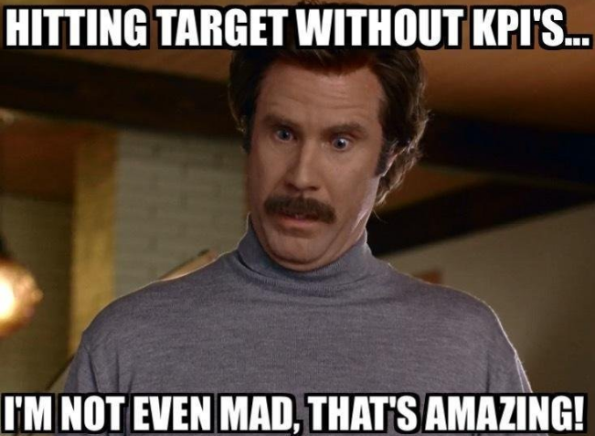

Slide 5


Slide 6

Key Consideration
  A perfect list of KPIs for our industry does NOT exist!
  “But why NOT????”

Slide 7
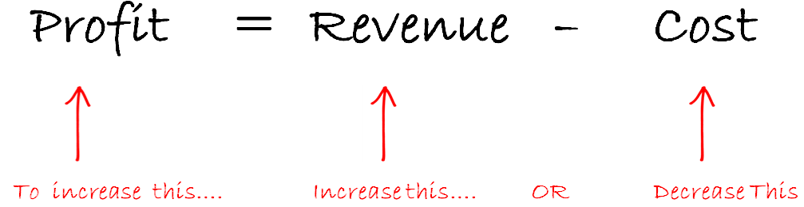
#1 – Revenue per Trip
Why is RPT Important?

Slide 8
Revenue per Trip (RPT)
Why is this the MOST important of all industry KPIs?
  Operational efficiencies are mostly attached to scale
  Labor-intensive industry
  Most businesses are living month-to-month without long-term planning
  Technology challenges

Slide 9
Revenue per Trip: Calculation (Basic)
  RPT = Total Revenue / Number of Trips

Slide 10
Revenue per Trip: Calculation (Intermediate)
  RPT = Total Revenue / Number of Trips
Local Revenue vs. Nationwide & Worldwide Revenue
      Separate revenue between local in-house, local farm-out, and
      out-of-market affiliate revenue
      Calculate basic RPT above for each bucket

Slide 11
Revenue per Trip: Calculation (Advanced)
  RPT = Total Revenue / Number of Trips
Separate your local (in-market) revenue by vehicle type
Calculate basic RPT for each vehicle type
Compare to historical values
Simple Profitability Calculator.xlsx

Slide 12
Revenue per Trip
How to improve it:
Provide incentives to CLIENTS to book longer trips
Provide incentives to your TEAM to book longer trips
Move toward larger vehicles whenever you can
RAISE your prices when you can

Slide 13

Q & A

Slide 14
#2 – Farm-Out Profit Margin %
Why it is important:
Farm-out cost is one of our industry’s largest expenses
May be the one you have the most control over!

Slide 15
Farm-Out Profit Margin %: Calculation
BASIC:
Farm-Out PM % = Farm-Out Revenue – Farm-Out Cost
            Farm-Out Revenue
ADVANCED:
  Calculate it per vehicle type
  Calculate it for LOCAL farm-outs vs. nationwide/worldwide farm-out

Slide 16
Farm-Out Profit Margin %
How to improve it:
You should not accept the work if you know you will have to farm
it out at a loss or a very low margin
Beware of profit margin shrinkage:
  Miscellaneous charges
  CC processing fees
  Cost of Service Incident Management

Slide 17
Farm-Out Profit Margin %: Continued
How to improve it:
Local
  Forecast fleet utilization and needs
  Charge more for last-minute calls during the busy season
Nationwide/Worldwide
  Confirm pricing structure prior to quoting your clients
  Know your clientele and sub-contract accordingly
  Price-in service recovery margin shrinkage

Slide 18

Q & A

Slide 19
#3 – Driver Payroll as a % of Revenue
Why it’s important:
If more than 2/3 of your work is local, it’s likely your largest
expense
Clients don’t pay for overtime!
Cost overruns are most prevalent here!

Slide 20
Driver Payroll as a %: Calculation
= Total Driver Payroll + (Taxes & Benefits)
            Revenue

Slide 21
Driver Payroll as a % of Revenue
How to improve it:
Spot audit of timesheets
Forecast Service Demand ➔ Forecast Driver Needs!
Incentivize your dispatchers for limiting OT
Set target OT percentages for busy and slow seasons
Know your farm-out profit margin so that you can make informed
farm-out vs. OT decisions

Slide 22
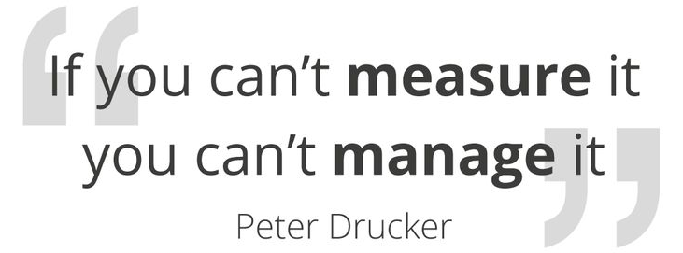
Q & A

Slide 23
#4 – Dispatch/Reservations Payroll as a % of Revenue
Why it is important:
A measure of productivity for your dispatch and reservations team
Helps identify fixed costs to calculate break-even revenue

Slide 24
Dispatch/Reservationist Payroll as a %: Calculation
= Total Dispatch & Rez. Payroll (+ Taxes & Benefits)
            Revenue

Slide 25
Dispatch/Reservationist Payroll as a % of Revenue
How to improve it:
Track individual performance closely (incident %, sales $, etc.)
Cross-train with other administrative staff to perform
additional tasks during down time
Forecast staffing needs to limit OT
Seasonal staffing

Slide 26

Q & A

Slide 27
#5 – Admin Payroll as a % of Revenue
Why it is important:
A measure of productivity for your SALARIED team
Helps identify fixed costs to calculate break-even revenue

Slide 28
Admin Payroll as a %: Calculation
= Total Admin Payroll (+ Taxes & Benefits)
            Revenue

Slide 29
Admin Payroll as a % of Revenue
How to improve it:
Cross-training with other administrative staff to perform
additional tasks during down time
Outsourcing of various functions that may not require a full
time presence?
Seasonal staffing?
Temp help to reduce OT costs?

Slide 30

Q & A

Slide 31
#6 – Client Concentration & Turnover Rates
Why they are important:
Understand your vulnerability levels!
Forecast your revenue more accurately by measuring and
predicting retention
Not all clients are the same (pricing, cash flow, service
expectations)

Slide 32

Client Concentration & Turnover Rates

Slide 33
Client Concentration & Attrition: Calculation
  Concentration:
  Top 1 client = XX % of Revenue
  Top 5 clients = XX % of Revenue
  Top 10 clients = XX % of Revenue
  Top 50 clients = XX % of Revenue

Slide 34
Client Concentration & Attrition: Calculation
  Client Attrition Rate*:
  2017 TO Rate = 2016 client revenue that did not recur in 2017
  2017 Revenue
    * Calculate for previous year + rolling 3-year average

Slide 35
Client Concentration & Attrition Rates
How to improve it:
Identify new market segments in non-correlated
industries
Create sales goals based on growth targets and
experienced attrition

Slide 36

Q & A

Slide 37
#7 – Revenue Per Client
Why it is important:
Helps you understand the CLV (Customer Lifetime Value) of
your “typical” client
Helps focus your attention on the RIGHT clients
Helps clarify the discounting mistakes we all make!

Slide 38
Revenue Per Client: Calculation
BASIC:
  = Total $ Revenue
  # of Clients
ADVANCED:
Calculate it twice: retail/individual consumers; corporations
Side note: For your larger clients, calculate RPT to understand how
profitable each client is.
  * The larger the RPT, the more profitable the client probably is….

Slide 39
Revenue Per Client
How to improve it: (same as RPT recommendations)
Provide incentives to CLIENTS to book longer trips
Provide incentives to your TEAM to book longer trips
Move toward larger vehicles whenever you can
Offer nationwide/worldwide services
RAISE your prices when you can!

Slide 40

Q & A

Slide 41
#8 – Accounts Receivable Turnover Rate
Why it is important:
Entrepreneurs are notoriously bad cash-flow managers!
Revenue and profit margin are great indicators of success,
but cash flow is one of the biggest challenges in this industry
Help to identify trends in your customer payment history
and proactively address any concerns

Slide 42
Accounts Receivable Turnover: Calculation
BASIC:
“Average Days to Pay” Report in QuickBooks
ADVANCED:
  = (Beginning A/R + Ending A/R) / 2
Total Sales

Slide 43
Accounts Receivable Turnover Rate
How to improve it:
Assume pre-payment or CC payment
Offer small discounts in exchange for early payment
For meetings and events transportation, ask for 50-80%
deposits
Charge late fees especially those with Net 30+ terms
Diversify your clientele types!

Slide 44

Q & A

Slide 45
#9 – Service Recovery as a % of Revenue
Why it is important:
A concrete measure of service failures
Customers are becoming more discerning with increased
competition: If you can’t compete on price, you must
provide great service!

Slide 46
Service Recovery as a %: Calculation
BASIC:
  = SR comp Account + Giveaways (gift cards, flowers, etc.)
Revenue
Considerations:
Are you tracking comps at all?
Are you separating SR-related comps vs. sales-related comps?
How about SR discounts (trips not fully comped)?

Slide 47
Service Recovery as a % of Revenue
How to improve it:
Track it
    Implement mandatory reporting for all service deviations
    24-hour resolution mandate
Identify innovative and inexpensive ways to satisfy customers
    Offer discount on future services vs. performed ones (may not be used)
    Offer free service vs. comp the current one ($70 future cost vs. $100 current revenue)
Implement incentives; hold team accountable for incidents

Slide 48

Q & A

Slide 49
#10 – Sales and Marketing as a % of Revenue
Why it is important:
“You gotta spend money to make money!”
You can’t calculate sales and marketing ROI without it!
Easier than most to benchmark
Consumer behaviors are changing rapidly: You need to re-
allocate your marketing spend regularly

Slide 50
Sales and Marketing as a %: Calculation
BASIC:
= Sales & Marketing Expense
Revenue
ADVANCED:
Calculate it for staff expenses vs. sales and marketing spend
Calculate it by marketing type: print, radio, social media, etc.

Slide 51
Sales and Marketing as a % of Revenue
How to improve it:
Budget for sales and marketing!
    Put someone else in charge of that budget
Track reservations from new customers by referral source
Your sales team should be involved in decision-making
    Better accountability for results
Adjust commission/bonus pay-out schedule for sales staff to
incentive toward more profitable business, not just volume

Slide 52
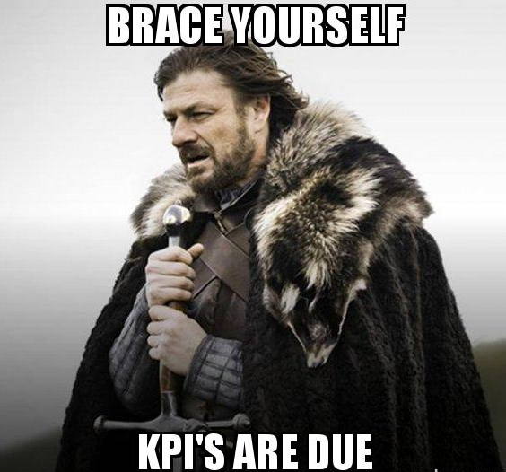
Q & A

Slide 53

Thank you for joining us!
Are you signed up for our Operator Mentoring Program, sponsored by Grech Motors? Then head to Woodrow Wilson A, where seating begins at 4:30.
Education Sponsor
Coffee Sponsor

