Slide 1



Networking 101:
Out of Your Shell and
Into the Mix
Presented by:
Tracy Raimer of Windy City Limousine and
Nancy Vargas of DH2 Chauffeured Transportation

Slide 2

Notes:
Introduce Nancy & Tracy. Ask the audience, who loves to network? (Have Nancy raise her hand.) Ask the audience, who would rather stick toothpicks in their eyes? (Have Tracy raise her hand.) Each take 2 or 3 minutes to provide our background and feelings towards networking. Briefly explain extrovert (nancy) versus introvert (tracy).
Ask the audience to network with each other for the next 2 or 3 minutes. (Take note of the feeling in the room, awkwardness, etc.)

Slide 3
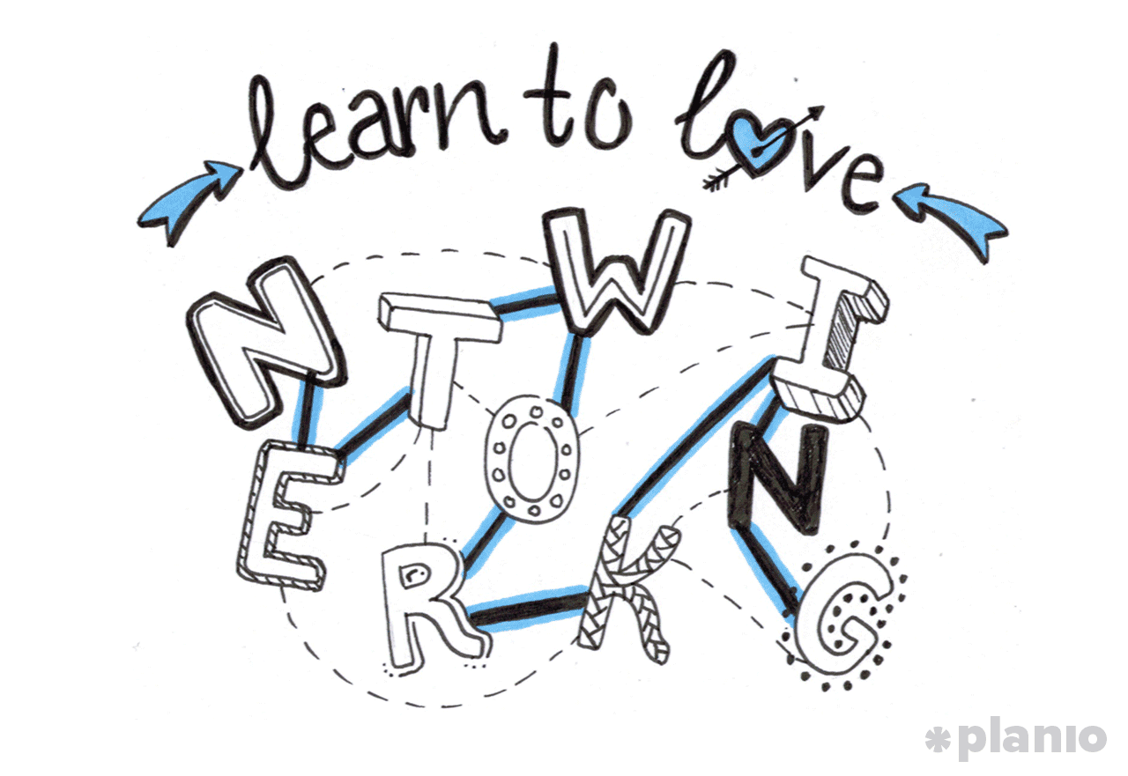
PREP-work before
Networking
Picture on Business Card
Choose the right associations or events to attend
Elevator Pitch
Plan who you would like to meet and arrange introductions prior to event
Dress professionally and appropriately
Keep it Fresh: gum, mints, etc.
Get ready to have some FUN!
Be Yourself!
Notes:
How to take the WORK out of networking. Tracy & Nancy – choose 4 points for each to talk about.
Nancy (first 4 bullets)
Picture on Business Card: Talk about my first experience coming to show several years ago and coming back to so many cards and remembering ones and not others. It prompted me to immediately reach out to Arthur at Create a Card and get my picture on my business card because I knew that people that I met thought the same
Choose the right associations or events to attend: Its important to choose an association that you feel you can commit to as well as give back. For example, I am Board Member at The JFK Rotary Club and have committed my time to attend luncheons, dinners, charity events, etc. I do the same for The JFK Chamber and I’ve had many great networking opportunities. I have also join the National Limousine Association and for instance took the time to attend The Day on the Hill in Washington DC. It was a great experience to speak to our Congressmen and such but I was able to mingle among my peers while there. I also belong to local limousine associations including a few outside of my market including The Illinois Limousine Association which Tracy is the President. Great content, education and networking opportunities. I also belong to one of Arthur Messina’s Driving Results Group and that has been a great source of support and education. Not only have I built a strong relationship with my group, I’ve also learned so much just by participating in the Wheels in Motion Group. These are all examples of how you can too get involved in your network and community.
Elevator Pitch: Craft your elevator pitch where you hit all the key points in a minute. You want to capture their attention as well as make them curious about you
Plan who you would like to meet and arrange introductions prior to event: Do your research prior to attending an industry show. You may want to arrange a meeting with a mentor, an affiliate you want to do business with or someone you already know that can help you make a warm introduction. Being proactive prior to attending the show will keep you organized and focused

Slide 4
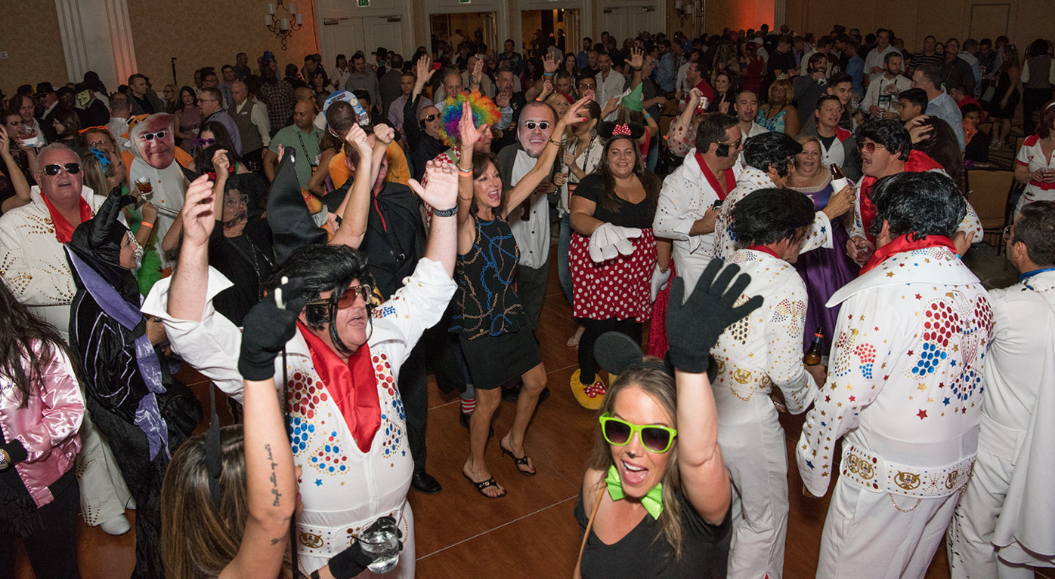
Notes:
Be Yourself!

Slide 5
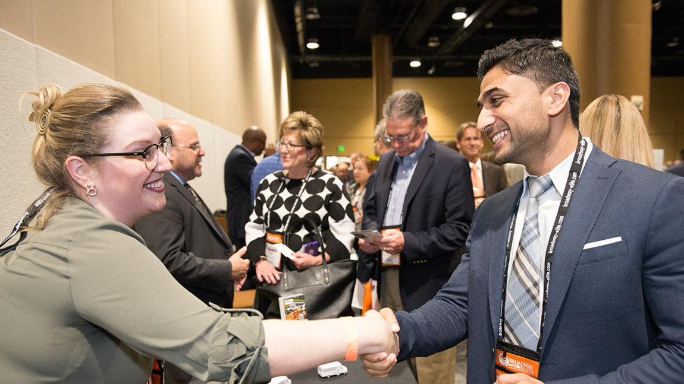
Notes:
Be Authentic!

Slide 6
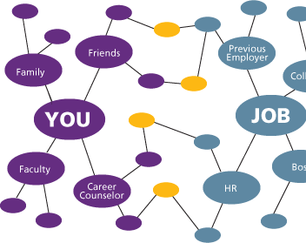
Places to network
Your Personal Network
Chambers
Rotary Club
MPI, GBTA
Bridal Shows
Local & National Associations
Most Importantly – JOIN COMMITTEES & GET INVOLVED!
Notes:
Tracy talk about Your Personal Network & Nancy talks about Chambers, Rotary Club, MPI, GBTA, Bridal Shows and Tracy talks about Local & National Associations. Starts talking about involvement and Nancy summarizes it with her personal examples.
Your local Chamber/Rotary/MPI/ GBTA: Your local Chamber and Rotary Club is a great tool to stay involved and network among local businesses that will help each other with referring business. If you are heavily invested in the Social/Wedding sector, plan to be involved and take a booth at a local bridal show. This puts you right in front of your audience and gives you the opportunity to hand out your marketing materials, set up appointments and showcase your vehicles at times. So depending on what sector of your business you have a niche, plan to join committees and shows.
Nancy’s summary: After attending my first show, I made a conscience decision that I would attend as many industry shows as my schedule permits it, I would get involved in local and our National Limousine Association and I became very active in my local chamber and rotary club. All great resources. I was able to grow my Affiliate Partnerships through my attendance at the show and then follow up with a Site Visit to show my commitment. I was able to get new business through referrals or learning of recent RFPs in my local airports and you just simply have to make a decision on how committed you will be with your time

Slide 7

Conversation starters
What brought you here?
How’s it going?
How do you know the host?
How have you been?
What are your biggest challenges/dreams/wants?
Tell me about yourself.
Notes:
Tracy will take this one.

Slide 8

Conversation movers
How so?
Tell me more.
What does it look like? Sound like?
Say more.
BE CURIOUS!
Notes:
Nancy will take this one. Time to do a quick roll play? Ask someone to tell us about themselves and ask the ‘Mover’ questions to show how much more we learn. By using the conversation movers, how much more did we learn about the person? What did we discover?
Nancy would ask: “Hi my name is Nancy Vargas from DH2 Chauffeured Transportation. Someone from the audience would tell me their name and company name.
Nancy would ask: “So what brought you here today?”
Nancy would ask: Oh wow that sounds interesting. So tell me a bit more about your company?
Nancy says: Do you see how much more I discovered about that person? The conversation starters and movers allows you to be curious and learn more.

Slide 9

Top Networking Tips while you are here at chauffeur driven!
Show up early to mingle.
Express interest in others and not just yourself.
Ask questions and listen carefully.
Be Personable – Use Eye Contact.
Take notes on business cards
Take advantage of seminars & networking opportunities.
  Join a benchmarking group or mentoring program
Be prepared with topics of conversation
Please – DON’T be pushy.
Stay Hydrated; EASY on the Alcohol!
Notes:
Tracy - Have program in our hands to point out seminars, networking events, operators mentoring program, women in the industry, affiliate connect, benchmark breakout groups and opportunities at the shows for awesome networking. Networking is a bit easier as you are amongst your peers and have common challenges, goals and aspirations. End the discussion with the last bullet point. You are always ON – always on stage while you are here! First impressions are key, you paid to be here, don’t leave the impression where you have to wait until the next show to present a better impression.
Focus on taking advantage of seminars and networking opportunities and stay involved
Be sure not to be pushy about your company because we are all in the same line of business and we want to build relationships not sell
Easy on Alcohol – stay focused as to why you invested money to come the show. Remember that these are the people that you will potentially do business with and you don’t want to embarrass yourself because you had too much to drink

Slide 10

Top Networking Tips while you are at a local event.
Know in advance who is attending.
Attend events with a partner and introduce each other to those within your network.
Don’t be afraid to ask for a warm introduction.
Focus on developing relationships and not selling.
Be prepared to discover how you can contribute to those that you have met.
Sit next to someone you haven’t met; Introduce yourself to someone that is alone.
Move on politely and not abruptly
Plan to Farm and Water the seeds rather than Hunt.
Plan to have a HOST mentality vs being a guest.
Notes:
**Should we rethink about how much is on this slide?? Is it too wordy***
Nancy - Focus on HOST mentality. End this slide with the audience networking using the HOST mentality. Summarize how the room felt differently, more energy, the chatter was louder more passionate, etc.
Its important to know who is attending in advance and if its your first time, it could be learning about the speakers, mentors, etc.
Attending an event with a partner can be helpful to a warm introduction to someone perhaps you wish to do business with and your partner can vouch for the work that you do in your market: how reliable you are, great vehicles, operations, etc.
Don’t be afraid to ask for warm introductions to those that you are already doing business with. It will be their pleasure to introduce you and speak highly of your business
Developing relationships vs selling is key. Think of it as Watering the seeds rather than hunting for meat. The more you water the seeds, the beautiful blooms will become flowers and you will see the fruit of your watering by gaining business without hunting to get that dollar.
Contributing to those that you have met is also key. It

Slide 11
DO’S & DON’TS
Bad mouth your competitors
Forget your business cards
Speak politics, religion or ask personal questions.
Spend so much time speaking about you and your company.
Monopolize people’s time.
Measure your success by the number of cards you hand out or collect!
Notes:
Tracy

Slide 12
DO’S & DON’TS
Focus on quality over quantity
Craft your 30 second elevator pitch
Keep eye contact and remember first names
Plant your seeds rather than hunt
Be a HOST
FOLLOW UP & STAY CONNECTED
Notes:
Nancy
Focus on having meaningful conversations vs trying to get to everyone in the room and you could have missed a great opportunity
Make sure you have your 30 sec elevator pitch ready to share so that in a pinch you can let someone know about yourself, your market and your company
Having eye contact vs scoping the room and remembering first names will take you a long way. Make sure that you have grabbed that person’s attention and that they have yours.
Planting and watering the seeds has so much more rewards than hunting to do you sell. People find you more interesting when you are willing to contribute to them vs what can they do for you.
Having a Host mentality at a show or at a networking event is critical because you are welcoming the people you are meeting as a host or a giver. You will find this to be rewarding and will make you feel good. Your return will come in a much more organic way.
You must follow up after every event you attend and the key thing is to stay connected. You know the saying, “Out of Sight/Out of Mind” so politely stay in touch and you will be surprised how this can lead into new business because its all about the right timing. It may not happen when you first meet but along the way, the people you have touched will think of you when they are someone in their network need your service.

Slide 13
Be a net giver, discover others

Slide 14


Slide 15
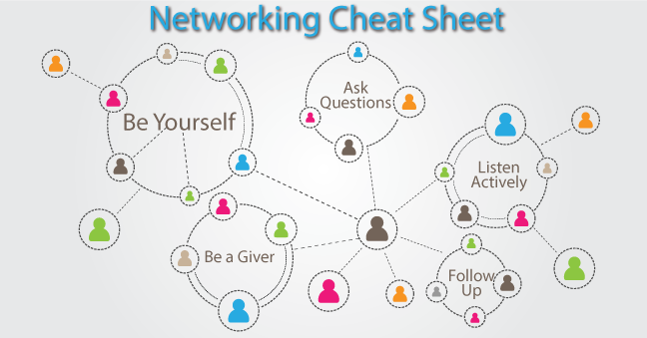
Notes:
Engage the audience to talk about networking with millennials and online networking.

Slide 16

Thank you for joining us!
You won’t want to miss our next session, Fine-Tuning Your Onboarding & Training Practices for Greater Success, which starts right here in 15 minutes.
Education Sponsor
Coffee Sponsor

