Slide 1


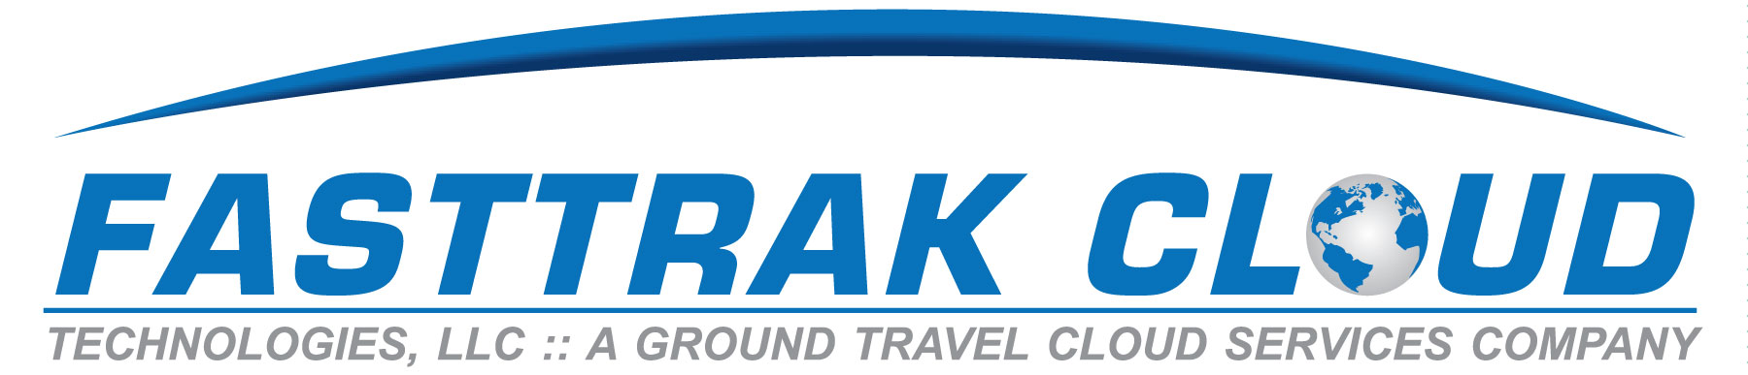
Fine-Tuning Your Onboarding & Training Practices for
Greater Success
Presented by:
Christina Davis of The LMC Group and
Clayton Dennard of Going Coastal Transportation

Slide 2

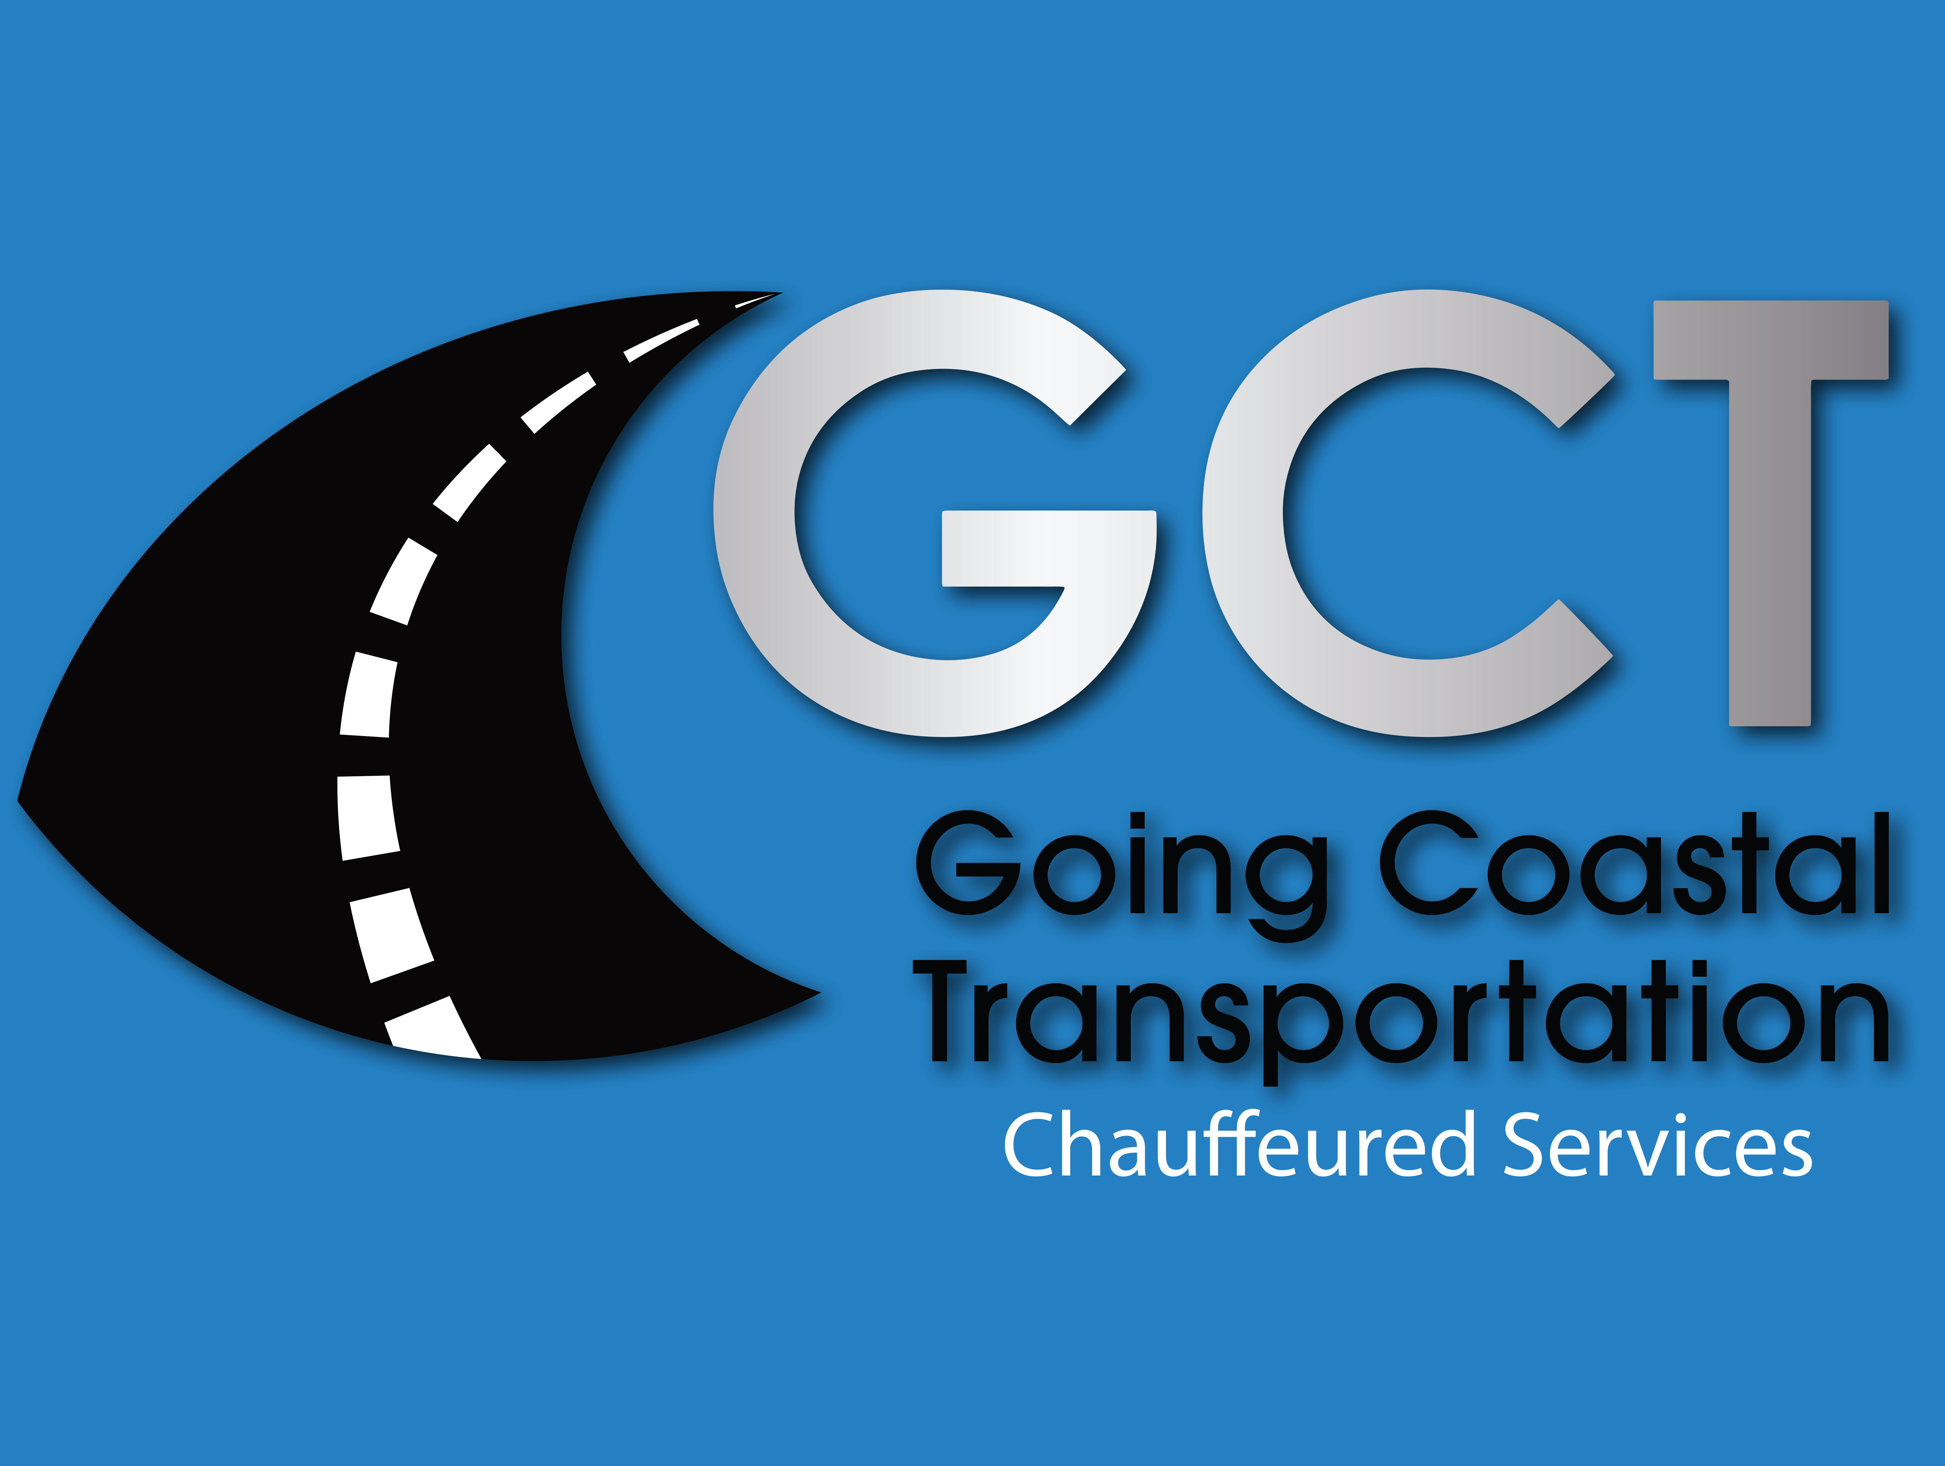
Fine-Tuning Your Onboarding & Training Process
Christina Davis Clayton dennard

Slide 3
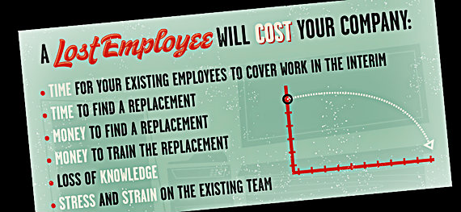

Slide 4
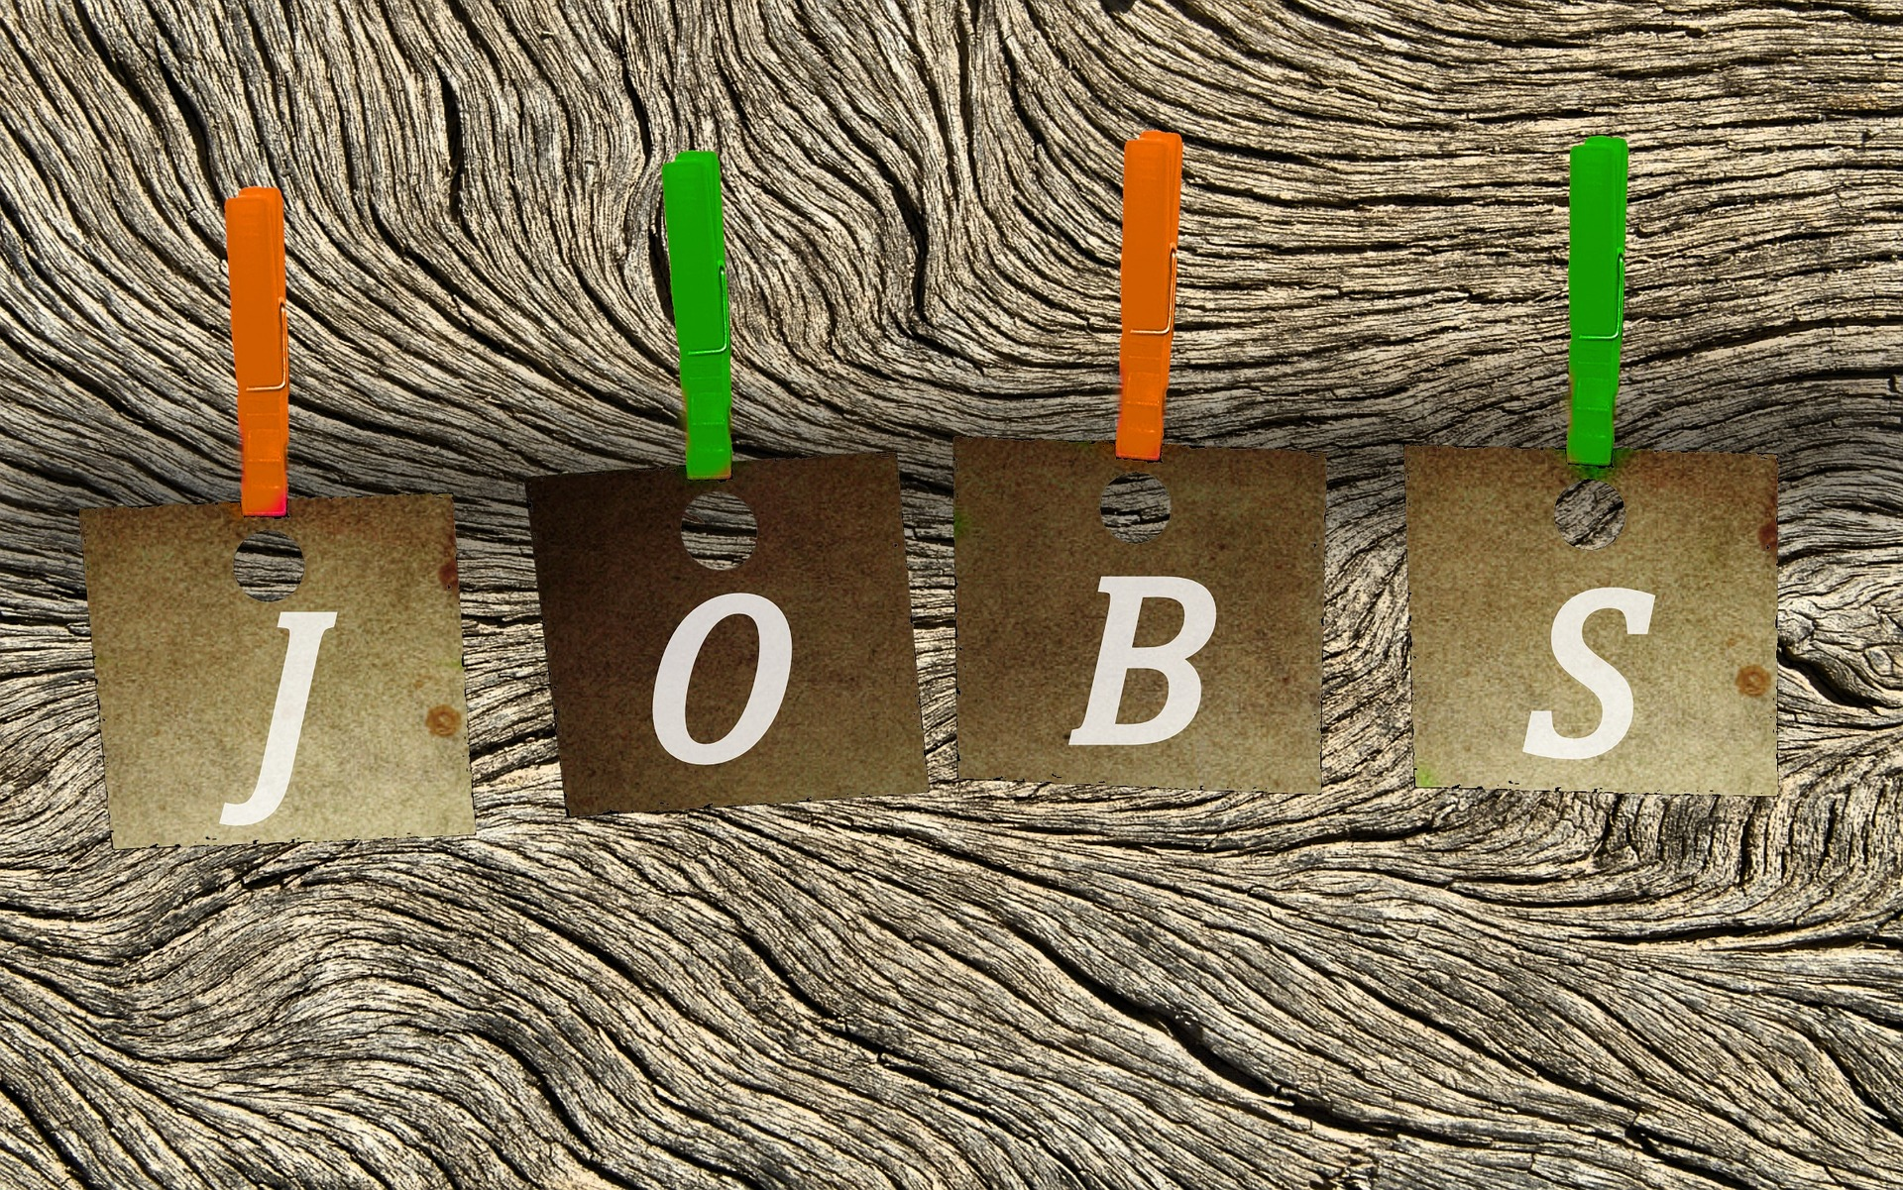

Slide 5
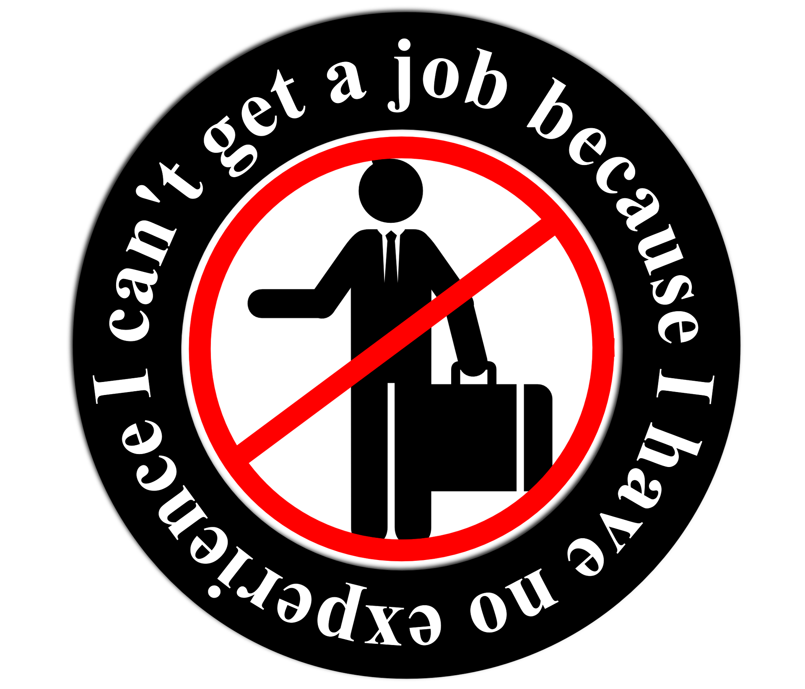
The Application

Slide 6

The Interview

Slide 7
“If they do it often,
it isn’t a mistake;
it’s just their behavior.”
Dr. Steve Maraboli

Slide 8
Specific Examples…
  “Tell me about a time when…”
  “Share with me when…”
  “Give me an example of a situation when…”
  “When have you been…”

Slide 9


Slide 10



Slide 11


Slide 12

Downsides to not having an organized training program
New employees are at a disadvantage when starting work in a new and unfamiliar environment
Incomplete hiring process
Misinterpretation of handbook and policies
Lowered expectations
Business loss

Slide 13
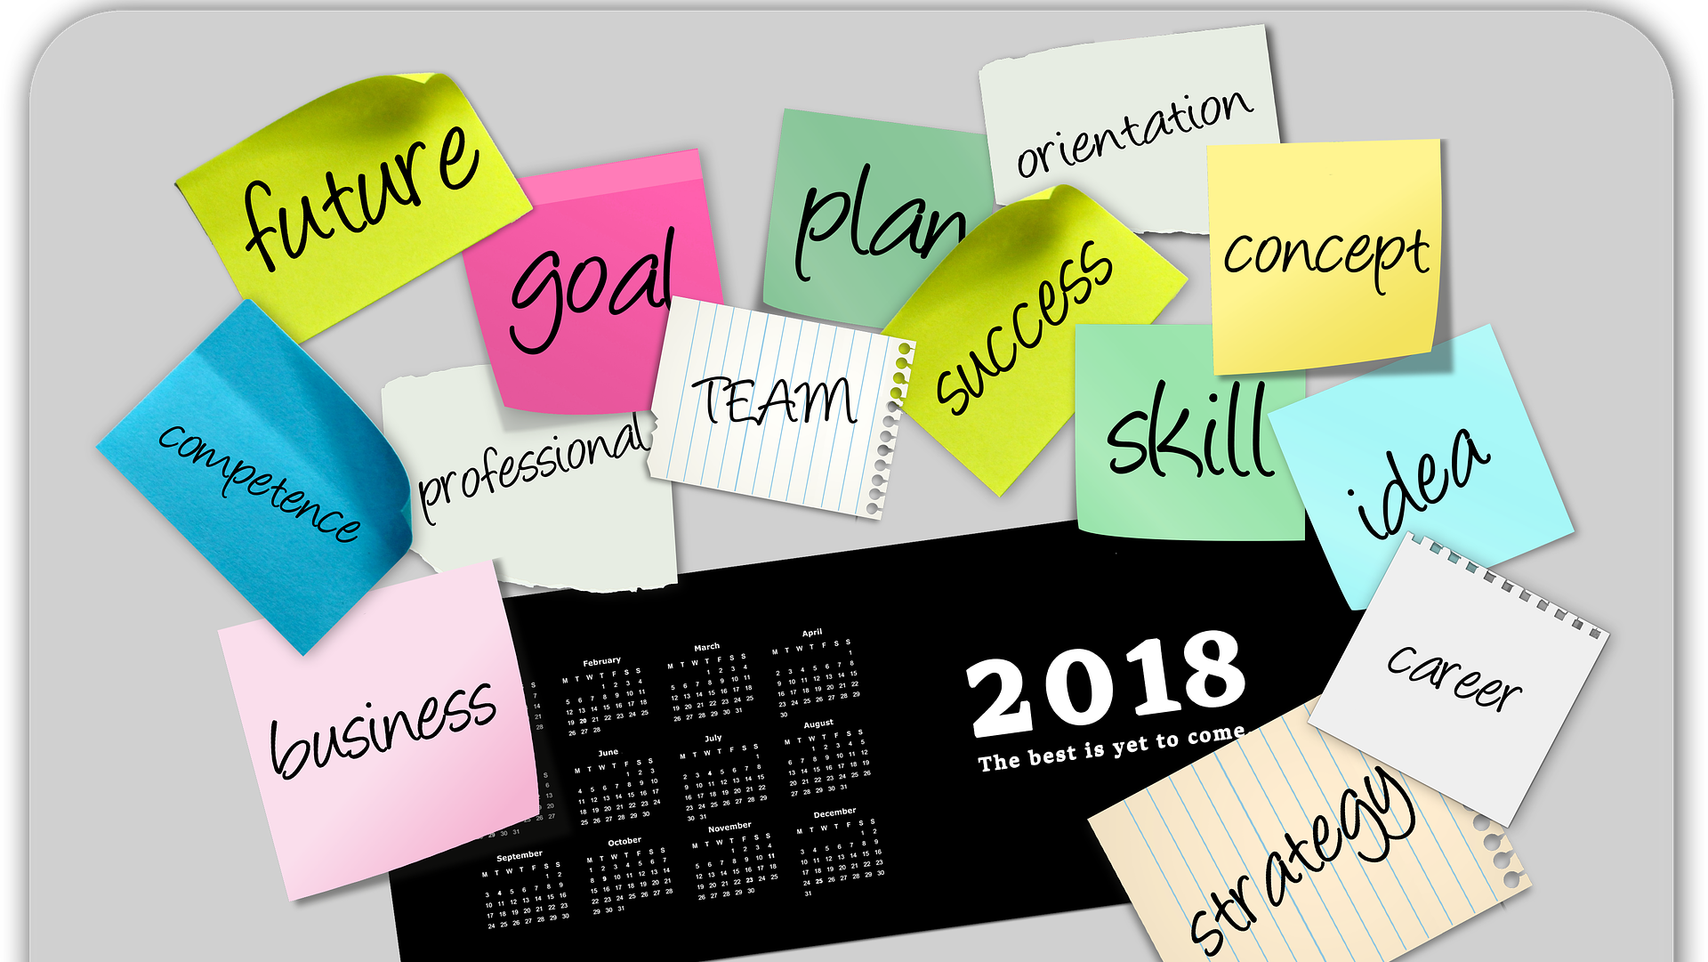
Upsides to having an organized training program

Slide 14
Welcome to the Team!

Slide 15
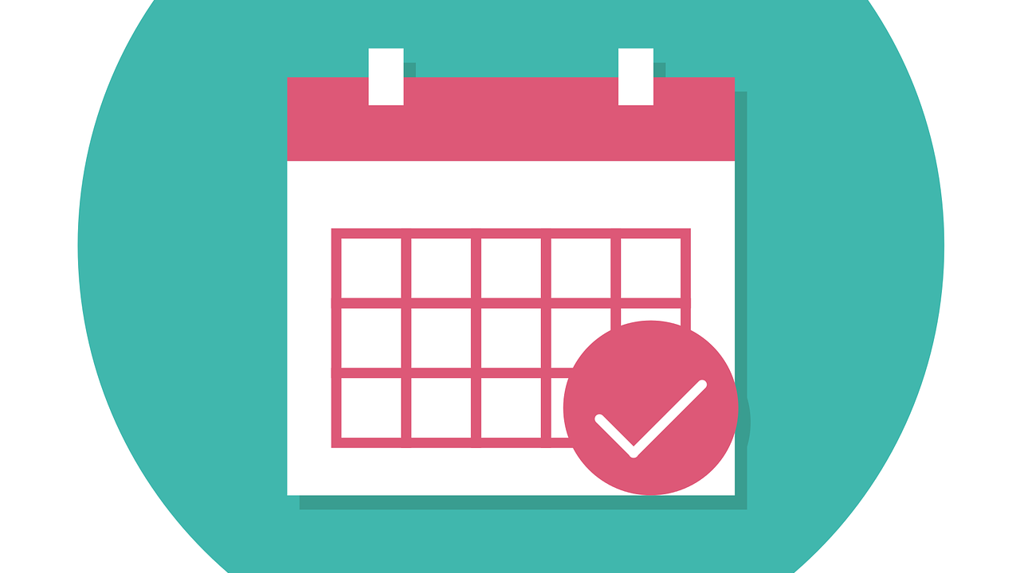

Slide 16


Slide 17

Train, Refresh, Retrain….
Continue to Grow…
40% of employees with poor training leave their jobs within the first year.
- go2HR
68% of employees claim that training and development are the most important company policies.
- ClearCompany
Companies that invest in employee training enjoy 25% higher profit margin than companies that don’t.
- Huntington Post

Slide 18
Why ensure that the hiring, training, and onboarding process is fully developed?
Work harder
Are more efficient
Take pride
Sense of team
Fewer performance issues and terminations
Higher profits!

Slide 19
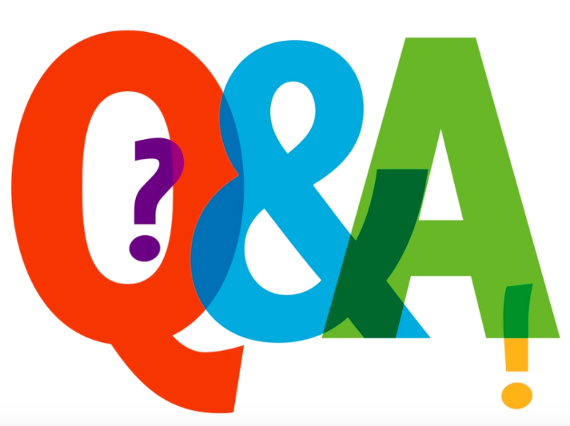

Slide 20

Thank you for joining us!
Stick around for our next session, Intro to KPIs: Industry-Specific Metrics Critical to Profitability, or head to Annapolis 3-4 for our Association Summit (sponsored by MCI). Both begin at 2:30.
Education Sponsor
Coffee Sponsor

