Slide 1
Values-Led Leadership: Driving Your Operation Straight to the Bank
Presented by: Kristen Carroll of The LMC Group and Kim J. Dolniak of BEST Transportation

Slide 2
LED LEADERSHIP
Kim J. Dolniak
President/Co-Owner BEST Transportation
Kristen Carroll
Founder and CEO The LMC Group

Slide 3
Case Study/Intro
Notes:
KRISTEN
Review with VW ad about clean diesel and the campaign that brought the concept of clean diesel to the US

Slide 4
Fined $30 Billion
$10 Billion in “buy-backs”
Average $5 Billion /year in profits – 8 years of loss
Executive Jail Sentences
Audi CEO Arrest – June ‘18
Notes:
KRISTEN
-The company overcame being founded by Hitler
-They reinvented themselves after being known as the hippy car
-They made diesel clean
-They lied
-They lost a lot of money

Slide 5
What happened?
Notes:
KRISTEN
-review the pressure and the decision making that led to this corporate crime
-how the culture was to make things work at any cost
-review the actual cost

Slide 6
STRONG VALUES LEAD LEADERS
Notes:
KIM
Now that was clearly an example of a company that headed the wrong direction with misguided values.
Let’s look at a few examples of companies that are vey successful with Value Led Leadership:
We will have 2-3 examples of companies from different industries.
Small Companies too
Female and male lead companies
Note: I am still deciding on the final companies (Kim)
Mention: https://www.forbes.com/sites/brentgleeson/2017/03/10/how-values-based-leadership-transforms-organizational-cultures/#3ac6209d1fbd

Slide 7
What is Values-Led Leadership?
Notes:
KRISTEN
-Explain what does the term Values-Led Leadership means
-Why it is important to an organization of any size. 5 team members to 100s.
-

Slide 8
Values-Led Leadership is a Business Strategy
Notes:
KRIISTEN
-why is that?
-what does it look like?
-what is the difference?

Slide 9
What does it look like if you do?
Notes:
KRISTEN
Practical examples for chauffeured car
What is the payoff to you?

Slide 10
Are you a Leader?
Who are you in this photo?
Notes:
KIM
One of the first thigs you must do to create a value lead culture is to ask yourself
Are you a boss (manager) vs leader?
What is the difference?
Boss/Managers – manage “tasks”
Leaders are innovative – always looks for new idea and new ways to do things
Empowering all to lead
Barking orders does not equate to leadership

Slide 11
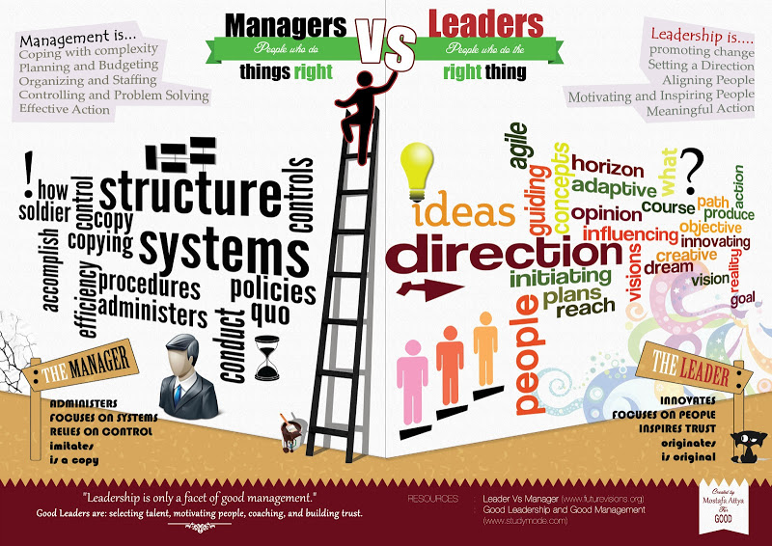
Notes:
Managers are…
*Task Focused
*We need to get things done (Have you ever said to yourself, “I can do better and quicker than one of my team so I will just do it?”
Be honest now ☺
*Micro Manager – do you double check your teams work or don’t allow them to take charge
*“In the weeds” – are you so much in the weds doing the day to day that you are working IN your business and not ON your business?
*Management is doing things right BUT Leadership is YOU doing the right things
In our industry there are times when we all need to be “managers” but we challenge you to become LEADERS
Now let’s look at what is a Leader
Innovative
When you are a leader it s energizing your team
Always looking to do things better, different, not happy with status quo
Leadership has nothing to do with us but it is about the TEAM.
Stretch them when appropriate.
Now I am sure some of you are sitting here saying BUT, I am a small operation and I have to cover dispatch, run trips or I just don’t have time. I get it! I was there too and in the beginning at BEST I would take the phones home and cover dispatch. But as an owner I had to carve out tie to be a LEADER, invest in my team, set the right Value Led Culture, allow them to earn and grow.
It is not easy and it takes times but you can do it.

Slide 13
Leadership Question 1
When you walk into the room, does your team stops talking?
Notes:
KIM
When you walk into the room your team stops talking?
If you answer TRUE the sit down
BE TRUTHFUL

Slide 14
Leadership Question #2
Do you do 60% of the talking when in meetings?
Notes:
KIM
You do 60% of the talking in meetings?
If TRUE the sit down

Slide 15
Leadership Question #3
Do your meetings get off-topic and take much longer than expected?
Or does your five-minute conversation with a team member turn into a 50-minute conversation?
Notes:
Your meetings get off topic and take much longer than expected? Or your 5 minute conversation with a team member turns into a 50 minute conversation.
IF TRUE, then sit down.

Slide 16
Leadership Question #4
Do you see the same problem multiple times with your team?
Notes:
KIM
You see the same problem multiple times with your team?
If YES then sit down.

Slide 17
Leadership Question #5
Are your team members NOT learning new things? Are they NOT thinking outside the box?
Notes:
KIM
Team members are NOT learning new things? They are NOT thinking outside the box?
If that answer is TRUE the sit down.
Now let’s see who is standing. Look around.
Kim & Kristen will say let’s give them a HUGE ROUND of applause because they are clearly LEADERS and on a great path.
Your reward….(Kim to give out a lapel pin to each for them to wear it and when you see them around the show the next few days you need to get their biz cards and think about doing business with them. Ask for tips.
Great job to all of you!
Now to all of you sitting….I am proud of you for recognizing that you have opportunities. I personally was recently in a leadership class and I had to sit down as I realized I had gotten off track too. Let these questions be a good baseline line guiding principle to help you truly achieve having a Values Led Company.
Here is a favorite quote of mine by someone that was pretty successful….
Read next slide – Steve Jobs quote.
Then Pass to Kristen

Slide 18
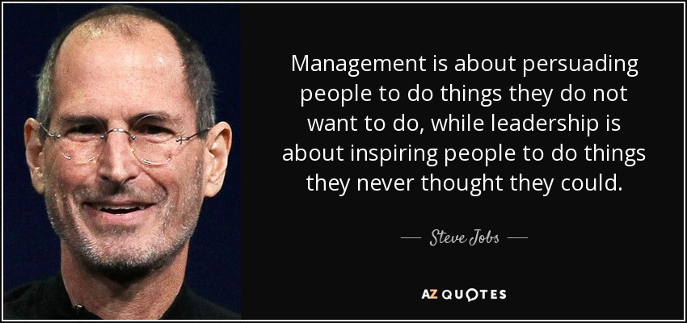
Notes:
KIM
Read Quote –
Pretty powerful point and I think we all know that Steve Jobs lead Apple to things no one every thought could happen and clearly was a Value Led Leader.
Now let’s Take a little Assessment of our own. Really be honest and think about in your current organization.

Slide 19
Company Values for Our Industry
Notes:
Kristen
Will talk about the LMC Playbook

Slide 20
Notes:
KRISTEN
She will show & talk about her LMC playbook

Slide 23
BEST Mission Statement Image Goes here
Notes:
KIM
Review our mission statement & explain how we use it every day in our company
*Visually hanging everywhere
*Part of our orientation training from the beginning
*written into all our internal communications & customer communications
But most importantly we LIVE IT everyday. If we have a customer or even a team member issue our team leaders will say “does our resolution fit with our values? Does it support our mission?

Slide 24
How to become a values-led leader
#1 – It must start with you!
Let’s each take a moment to COMMIT to ONE change we are going to make toward being a Values-Led Leader.
Notes:
KIM
Challenge the attendees to think of one change they can make immediately to take a significant step in the direction of becoming a values led leader
Write it down right now on a piece of paper or email it to yourself
If time allows….
We will ask the group for 1-2 examples

Slide 25
Moving Your Leadership to Create a Values- Driven Culture
Notes:
KRISTEN
We will have a handout with take away of the various steps and end results

Slide 26
Notes:
KRISTEN
What did we learn today on this Values Led Journey (ask them)
#1 – we do not want to be VW
#2 – We know companies of all sizes can PROFIT and GROW by committing to a Values Led Culture
#3 – We learned how to identify what is the difference between being a Manager vs Leader
#4 – You each committed to ONE thing you are going to focus on first to make yourself a better leader
#5 – We shared two examples from within our industry of Mission Statements/Core Values/Playbooks that you can use to think about creating that vision for your company.
#6 – We gave you a first step guide to take back with you.
#7 – We shared results and why it will benefit you, the pay off.
So that leaves us with Number 8
Kristen to say….Kim what is Number 8

Slide 27
#8 You have to do the first 7 if you want to go from….
Notes:
Kristen – wrap up….
So that leaves us with #8
#8 is….If you want to move from Good to GREAT you have to make it to number 8!!!!!!

Slide 28
Feel free to contact us for additional information.
Kim J. Dolniak
Owner
Kristen Carroll
Founder and CEO
Notes:
Kristen or Kim to say….
Thank you very much and please reach out to either of us with any follow up help or questions. Have Kristen’s Contact Info and logo here Have Kim’s info
Then say….
Now next Make sure you go to the Key Note Session so you learn how t take this and turn it in to True Profits for your company.
☺
The End

Slide 29
Thank you for joining us!
You won’t want to miss our State of the Industry (sponsored by FASTTRAK) right next door in Woodrow Wilson A.
Hurry—it starts at 9:45!
Education Sponsor
Coffee Sponsor

